Slide 1


LINKS
(Louisiana Immunization Network for Kids Statewide)
REMINDER RECALL

Slide 2
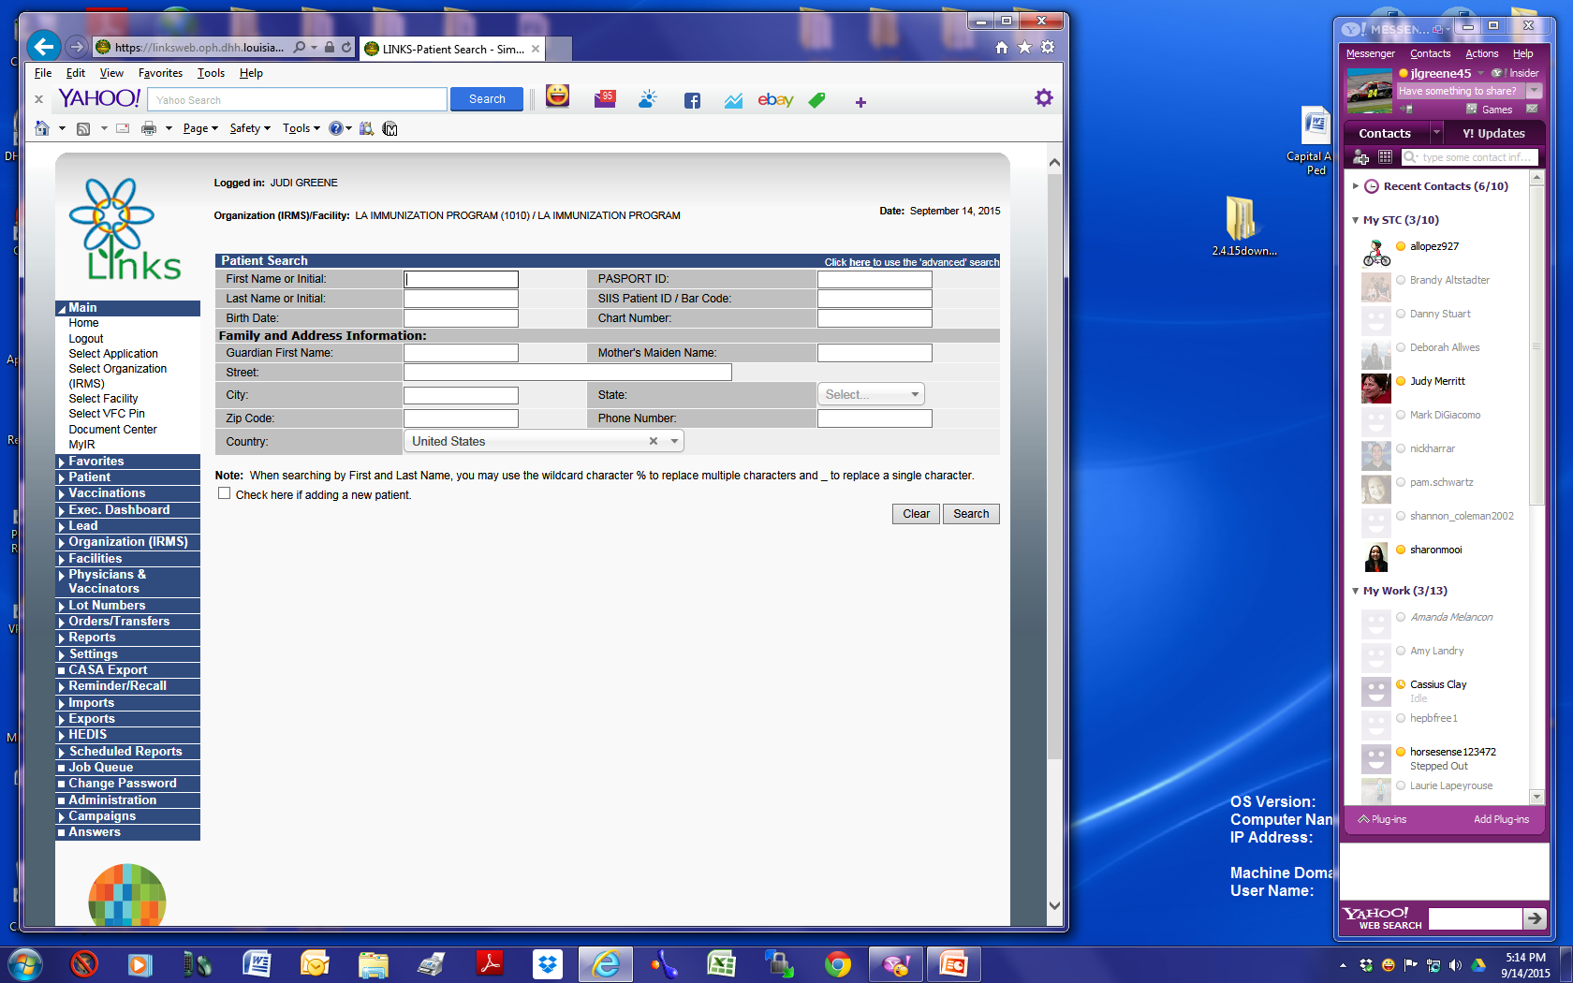
On LINKS Menu
Click on Reminder Recall

Slide 3
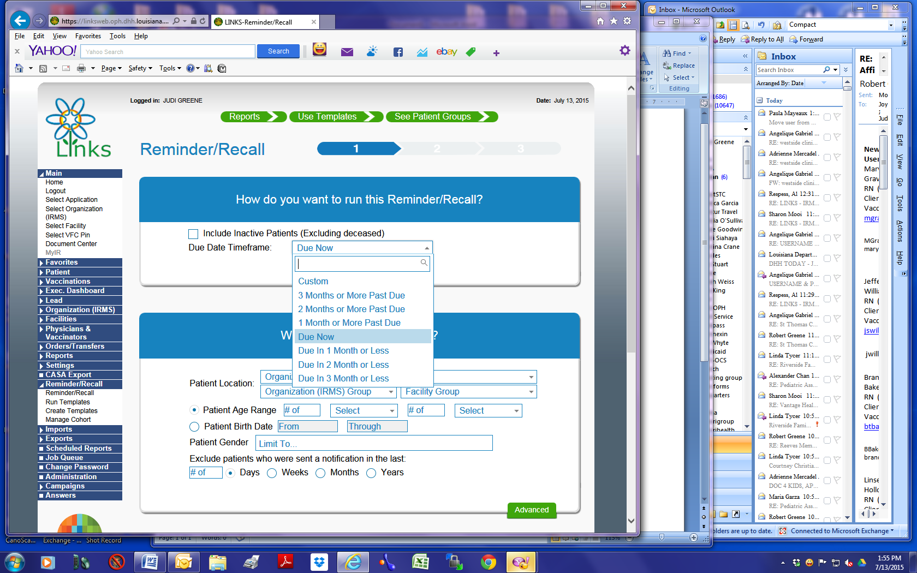
Choose your option on how to run reminder recall (Defaults to “Due Now”)

Slide 4
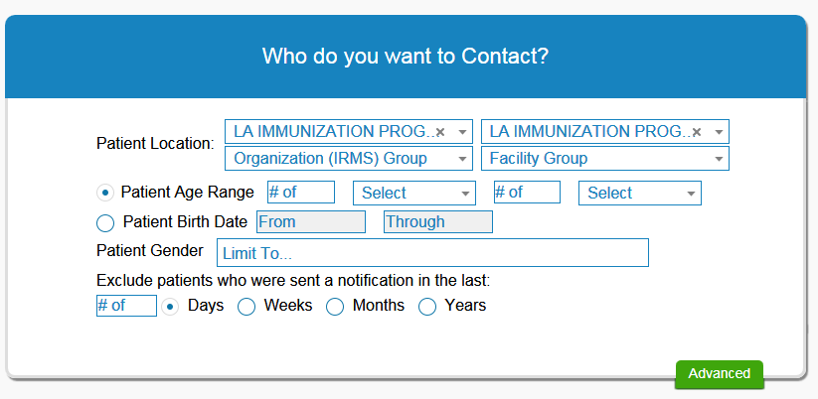
Select Who You Want to Contact
(Options to select Age Range, DOB Range, Gender, & how long since last recall was done)

Slide 5
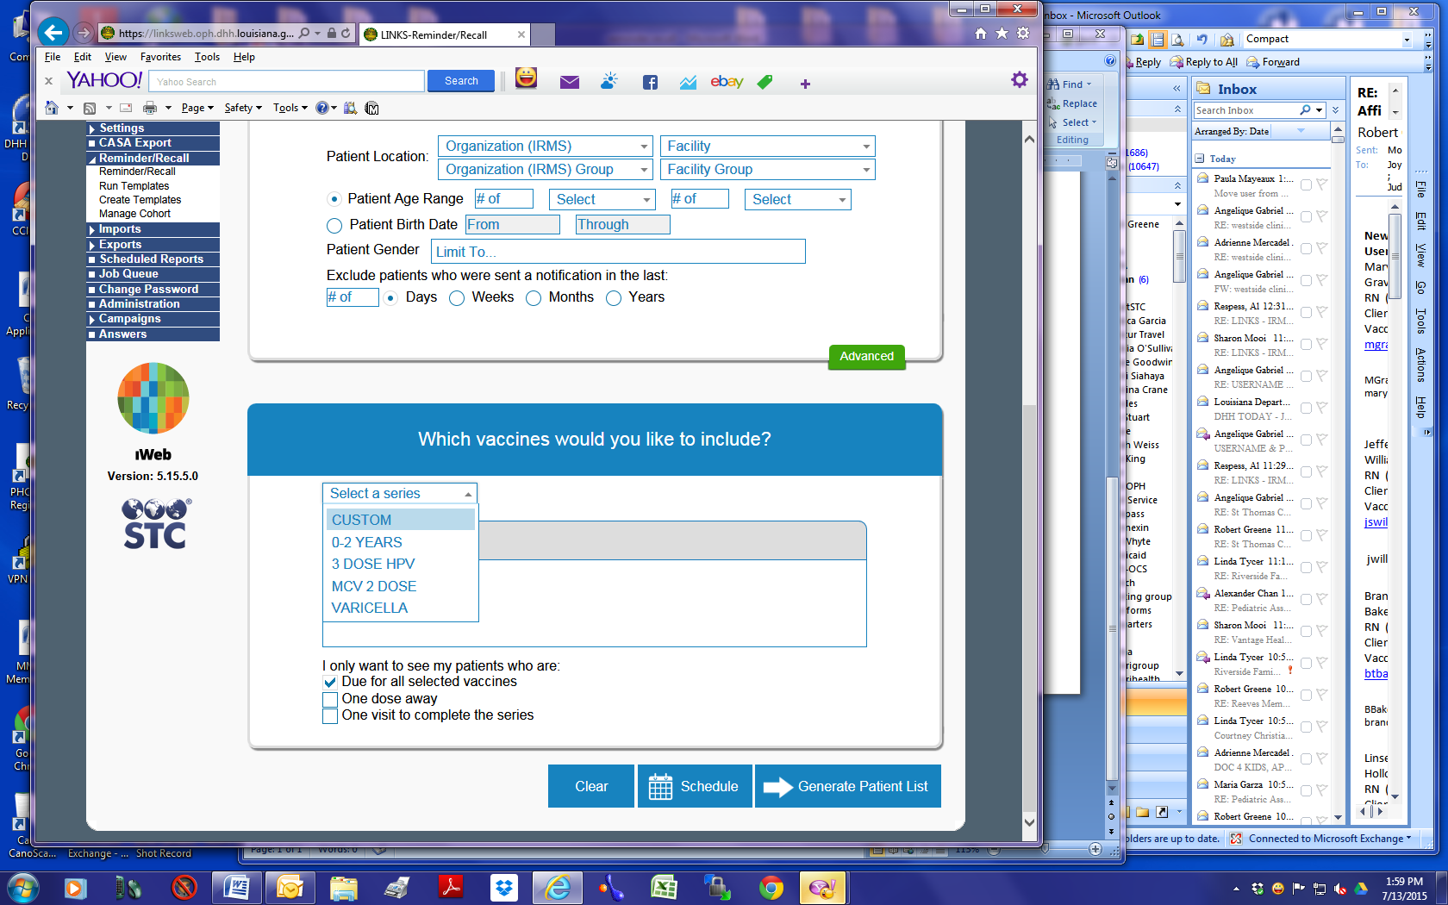
Select Vaccine(s) to include
(Default is to custom for you to choose the vaccines to include)

Slide 6
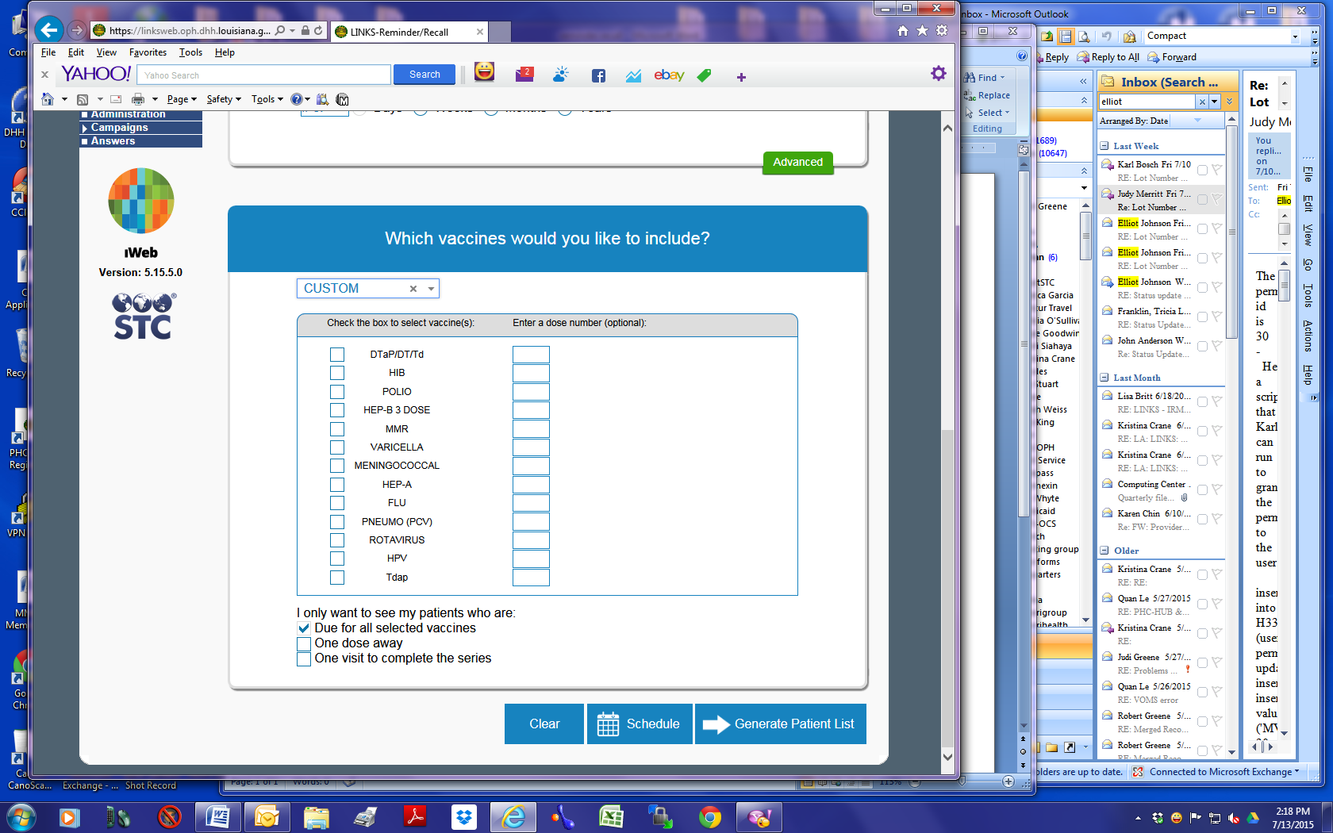
If Custom is Selected the next screen will have you select the vaccine(s) you wish to remind for
(Check each vaccine to remind for)
Click Generate Patient List

Slide 7
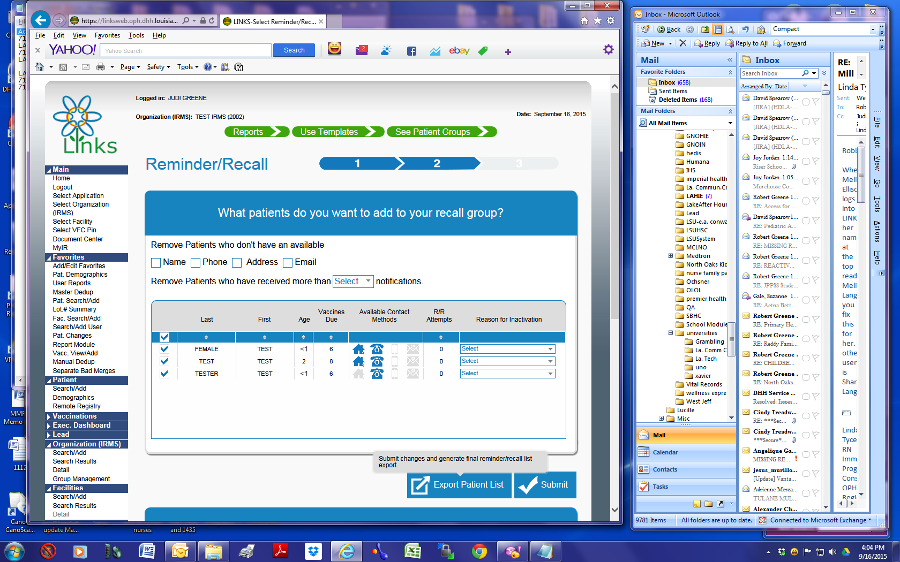
Options on this screen
1. Remove Patient with missing information
2. See information on patient by placing cursor over name
3. Inactivate patients no longer in the practice
When all options chosen click on Submit

Slide 8
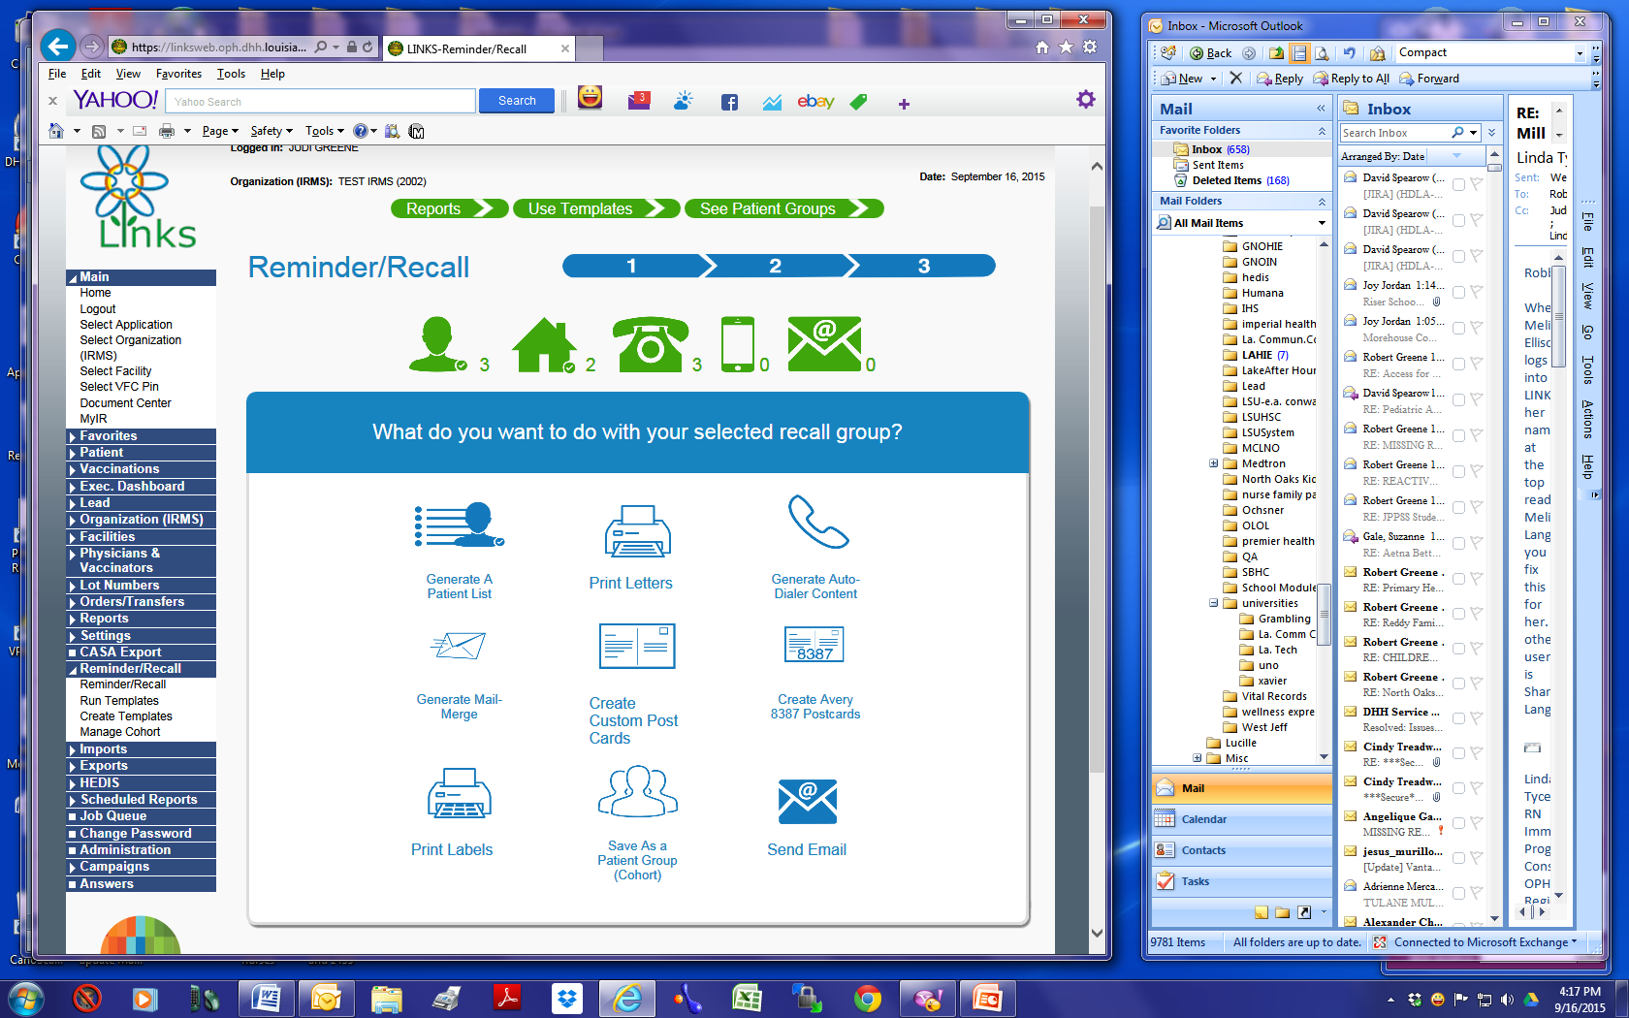
Select the type of recall you want to do and proceed
Note: The type of option you can use depends on information on patient demographic page.
(Example: If you collect the email address you can send email as reminder)

